Slide 1

PROJECT WORK IN MACHINE LEARNING CREDIT CARD FRAUD DETECTION
Professor
Claudio Sartori
Presented By
Yellam Naidu Kottavalasa
Matricola: 0000985387

Slide 2
ABSTRACT
It is vital that credit card companies can identify fraudulent credit card transactions.
Customers are not charged for items that they did not purchase.
This problems can be tackled with Data Science and its importance, along with Machine Learning.
Credit Card Fraud Detection is a typical sample of classification.

Slide 3
Contents
Introduction
Project Pipeline
Data Collection
Analyzing Data
Preprocessing
Model Creation
Evaluation of Models
Conclusion

Slide 4
Introduction
Unauthorized and unwanted usage of an account.
Necessary prevention measures can be taken.
Protect against similar occurrences in the future.
Fraud detection involves monitoring the activities of populations of users in order to estimate, perceive or avoid objectionable behavior, which consists of fraud, and defaulting.

Slide 5
Project Pipeline
Data Collection
Analyzing Data
Univariate Analysis
Bivariate Analysis
Data Preprocessing
Model Creation
Logistic Regression
Decision Tree
Random Forest
Evaluation Of Models
Accuracy
Precision
Recall
Confusion Matrix

Slide 6
Data Collection
Data collection is the systematic approach.
Gathering and measuring information from a variety of sources.
Containing 1,296,675 transactions of both legitimate and fraud transactions.
It covers credit cards of 1000 customers.
a pool of 800 merchants.
Test
Train

Slide 7
Analyzing Data
Process of inspecting, transforming, and modeling data.
Discovering useful information.
Here the data can be visualized in two ways. They are
Analyzing Data
Univariate Analysis
Bivariate Analysis
Univariate Analysis
Bivariate Analysis

Slide 8
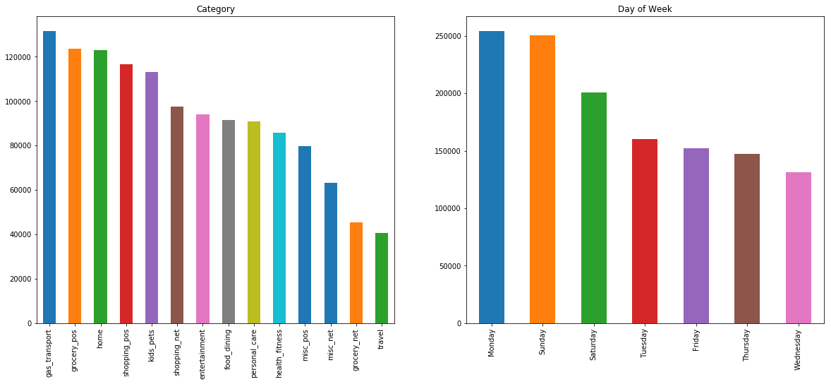
Project analysis slide 3
Univariate Analysis
To enumerative properties as well as a descriptive summary.
gas_transport of the category has the highest credit card transactions.
Sunday and Monday of the week have the highest credit card transactions.
Notes:
8

Slide 9
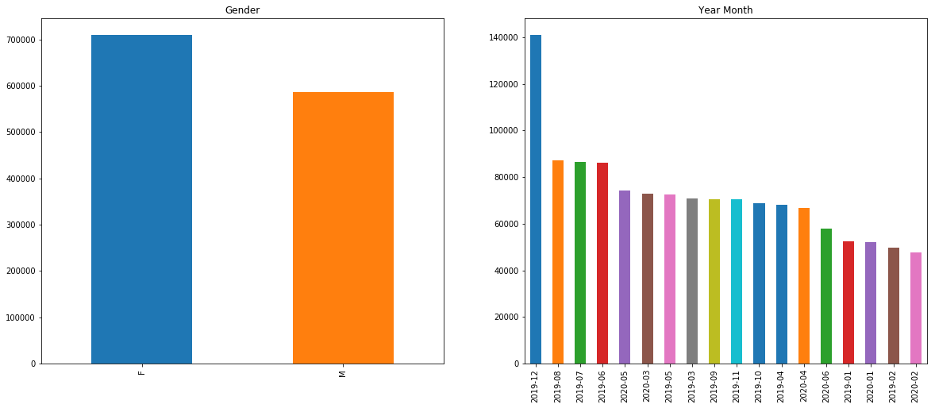
Females are done the more Credit card transactions compared to Male.
Highest number of transactions are in the month of December.
Lowest number of transactions happens in February month.

Slide 10
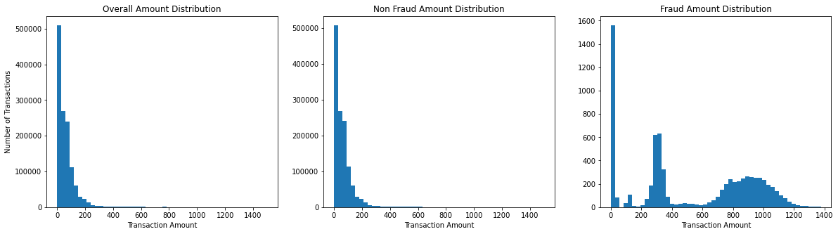
Bivariate Analysis
kind of empirical relationship between two variables.
Specifically, the dependent vs independent Variables.

Slide 11
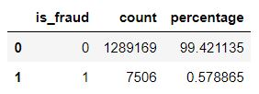
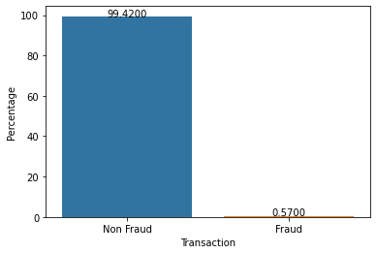
1,289,169 transactions are non fraud transactions.
99.42% are the non fraud transactions.
7,506 transactions are the fraud transactions.
0.57% are the fraud transactions.

Slide 12
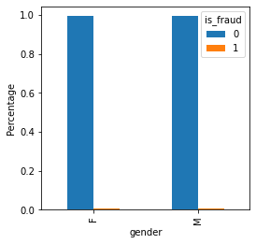
Most of female candidates are not done the fraud transactions.
Approximately 2% of the females done fraud transactions.
Most of Male candidates are not done the fraud transactions.
Approximately 2% of the Males done fraud transactions.

Slide 13
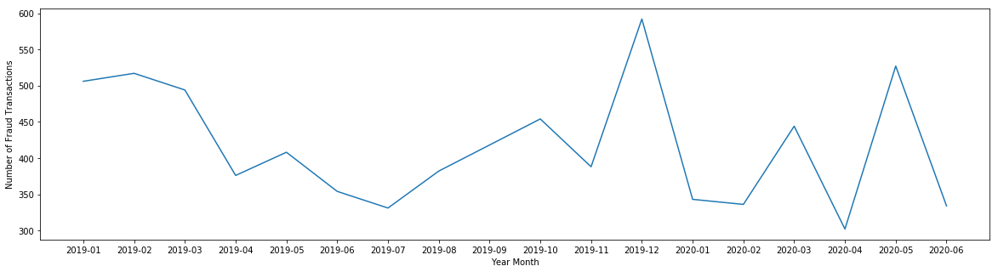
Project analysis slide 4
Plotting between the year month and number of Fraud transactions.
More fraud transactions are in the December month of 2019 and the lowest fraud transactions in April month of 2020.
Notes:
13

Slide 14
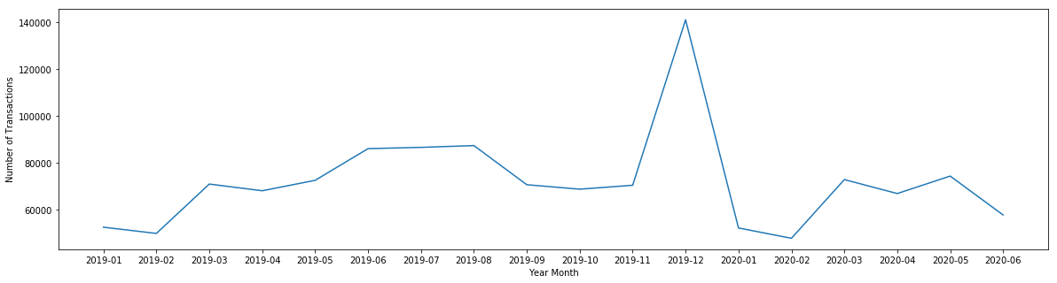
Plotting between the year month and number of transactions.
More number of transactions are in the December month of 2019 and the lowest transactions in February month of 2020.

Slide 15
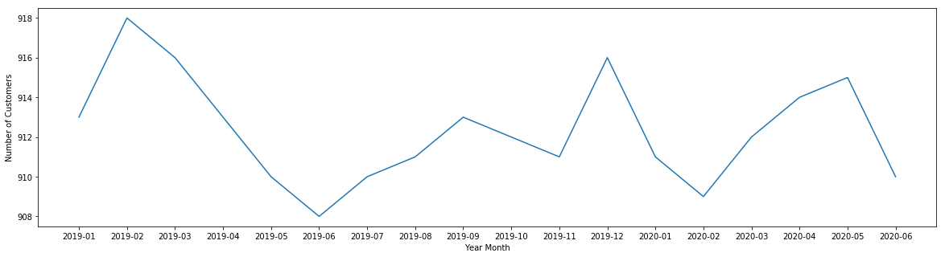
Plotting between the year month and number of Customers.
More number of customers are in the February month of 2019 and the lowest number of customers in June month of 2019.

Slide 16



Data Preprocessing
Data normalization is applied to some features.
To make model training less sensitive to the scale of features.
one-hot encoding can be applied to the integer representation
new binary variable is added for each unique integer value.
The Dataset is highly imbalanced
Oversampling involves randomly selecting examples from the minority class, with replacement, and adding them to the training dataset.

Slide 17
Project analysis slide 8
Model Creation
we can try different models.
Desired level of performance on the given dataset.
1. Logistic Regression
2. Decision Trees Classification
3. Random Forest Classification
Notes:
17

Slide 18
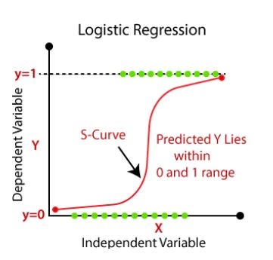
Logistic Regression
Logistic regression is a supervised learning classification algorithm
Predict the probability of a target variable.
Two possible classes.
Relationship between one dependent binary variable and one independent binary variable

Slide 19
Evaluation of Logistic Regression Model
Accuracy: 0.92
Precision for 0 class: 0.92
Precision for 1 class: 0.75
Recall for 0 class: 1.00
Recall for 1 class: 0.05
F1 score for 0 class: 0.96
F1 score for 1 class: 0.09

Slide 20

Decision Tree Classification
Supervised learning technique
both classification and Regression problems.
Preferred for solving Classification problems.
It is a tree-structured classifier
Internal nodes represent the features of a dataset, branches represent the decision rules, and each leaf node represents the outcome.

Slide 21
Evaluation of Decision Tree Classification Model
Accuracy: 0.96
Precision for 0 class: 0.97
Precision for 1 class: 0.97
Recall for 0 class: 1.00
Recall for 1 class: 0.14
F1 score for 0 class: 0.98
F1 score for 1 class: 0.25

Slide 22
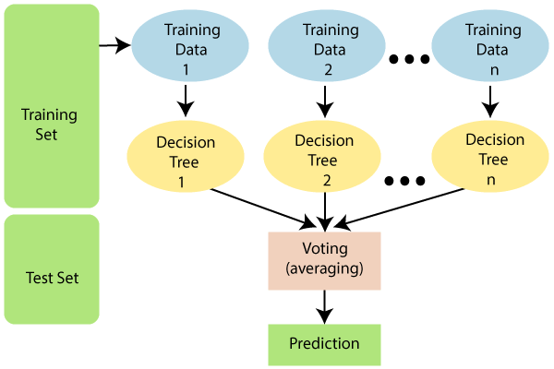
Random Forest Classifier
Supervised learning algorithm.
Most flexible and
Easy to use algorithm.
Creates decision trees on randomly selected data samples, gets prediction from each tree.
selects the best solution by means of voting.

Slide 23
Evaluation of Random Forest Classification Model
Accuracy: 0.97
Precision for 0 class: 0.97
Precision for 1 class: 0.85
Recall for 0 class: 1.00
Recall for 1 class: 0.14
F1 score for 0 class: 0.98
F1 score for 1 class: 0.24

Slide 24
Conclusion
An act of criminal dishonesty.
the machine learning can be applied to get better results in fraud detection.
Best Performer - Random forest Classification gives the highest accuracy is 97.03%
Worst Performer – Logistic Regression Model.

Slide 25
Thank You

